Slide 1
Ministry in Times of Church Discernment and Closure:
Webinar for Intentional Interim Ministers
Originally Presented
September 28, 2017

Slide 2
Sponsored by:
CHANGE HAPPENS
The Association of United Church of Christ Intentional Interim Ministers
We Can Help
Association of
United Church of Christ
Intentional Interim
Ministers

Slide 3
Sponsored by:

Slide 4
Sponsored by:

Slide 5
Sponsored by:
MESA
The Ministerial Excellence, Support and Authorization Team

Slide 6
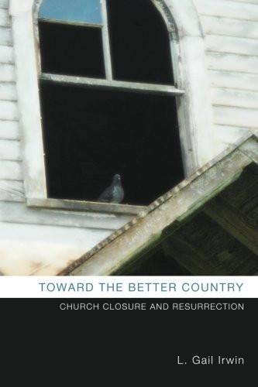
Resources
Most participants have chosen to receive a copy of L. Gail Irwin’s book, Toward the Better Country: Church Closure and Resurrection

Slide 7
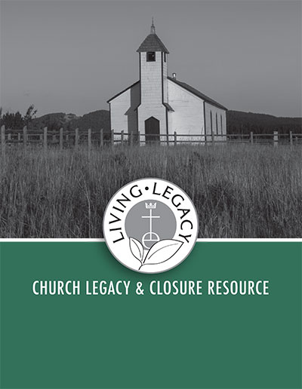
Resources
And a PDF Download of Living Legacy: Church Legacy and Closure Resource produced by Local Church Ministries, Church Building and Loan Fund, and United Church Funds.
We hope you will find these valuable in your work.

Slide 8
Churches Close Every Day
A UCC Congregation closes every two weeks. Among all denominations and traditions, nine churches close a day in the United States.
The average lifespan of a congregation is comparable to the lifespan of an individual, about 70-100 years.
Church closure is not new in the history of the church, but certainly presents a significant reality and missional decision for congregations in our times.
Despite the ongoing reality and normality of churches coming to the end of their life – like all of us – closure is often perceived as a failure of faith and mission.

Slide 9
Resurrection Faith, Closure and Legacy
“The rudder of a closing church is resurrection faith that new life will rise from the death of a congregation. It is faith that the church is not a building but the people of God. It is faith that God is present in the midst of grief. It is faith that God calls us to be good stewards of our blessings. It is faith that gratitude for ministry we’ve shared brings us closer to one another and to the heart of God.”
- Rev. Dr. Gail Cafferata, “Mind the Tiller: Leading a Church to Closure”
https://www.bu.edu/cpt/2016/10/28/mind-the-tiller-leading-a-church-to-closure/

Slide 10
Ministry in Times of Church Discernment and Closure:
Webinar for Intentional Interim Ministers
Gail Irwin & Jonathan New, Presenters
September 28, 2017

Slide 11
Threshold Churches – Threshold Moments

Slide 12
Threshold Churches – Threshold Moments
Revitalizing
Right-Sizing
Relocating
Relinquishing

Slide 13
The Uniqueness of this Ministry –
An Orientation
“I come to this effort with the belief that a faithful reshaping, merger, or closure may be more in keeping with God’s will than a strenuous effort to stay open at all costs.”
- Gail Irwin, Toward the Better Country, p.8

Slide 14
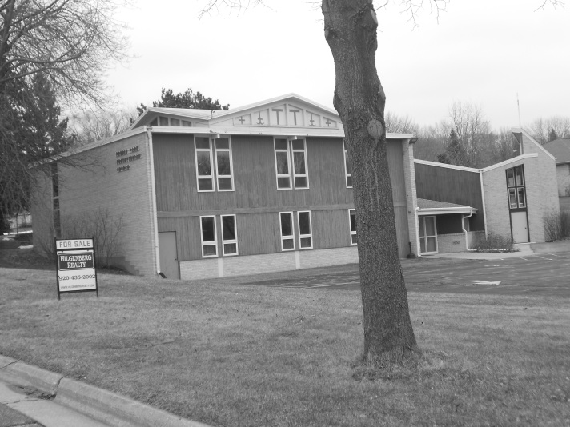
Preble Park Church

Slide 15
Talking About These Matters Can Be Difficult!
“I served as an interim at a very small congregation that never explicitly discussed or entered into a discernment process regarding their future but it was often underneath the surface.”

Slide 16
Challenges Arising in the Midst of this Ministry
Institutional Crisis
Mission Crisis
Pastoral Care Crisis
Ecclesiastical Crisis

Slide 17
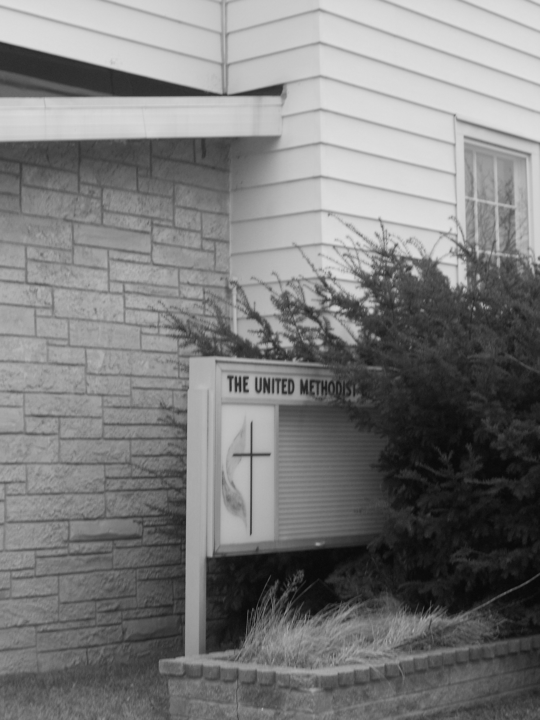
Research on Congregations &
Church Closure

Slide 18
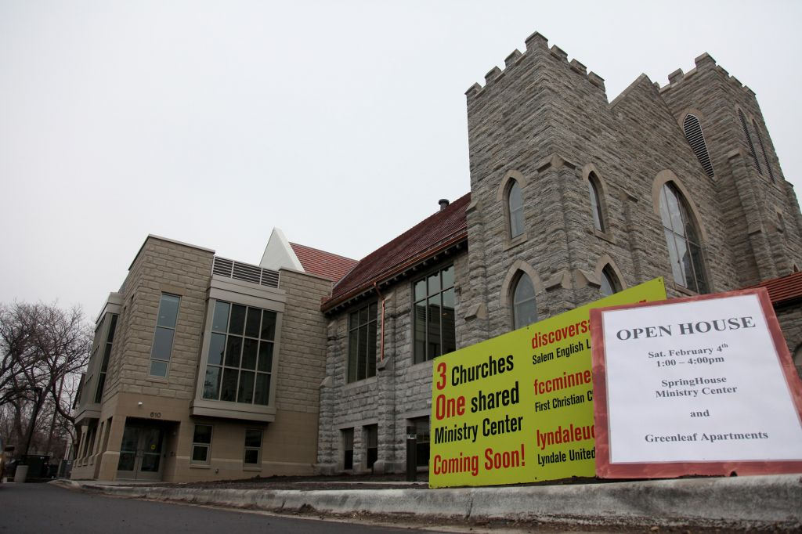
SpringHouse Ministry Center

Slide 20
The Uniqueness of this Ministry –
The Work
The Deepest Possible
Congregational Discernment

Slide 21
Congregational Discernment With
Threshold Churches
Some Churches:
are determined to forge ahead as if nothing is wrong
sense something is wrong but don’t know what to do next
have already decided closure is their only option
In all Cases – A discernment process is needed!

Slide 22
“It was very unintentional,
and I was more focused on revival
than listening to their needs.”

Slide 23
The Uniqueness of this Ministry –
Awareness
Significant Signs
&
Critical Moments

Slide 24
Failure to Thrive:
dropped opportunities for outreach/mission or unfinished projects
inability to embrace minor change without major stress
using all the assets for maintenance of the institution
obsession with conflict
entrenched denial

Slide 25
“I serve a church that believes they will ‘run out of money’ in five years. I want to be thinking about how to help them reach a decision on whether or not to continue being church together.”

Slide 26
A Healthy Discernment Process
planning ahead – not waiting until all resources are depleted
talking openly about the future and addressing emotions
connecting to the wider church and community
focusing on the mission that continues even when an institution cannot
“Separating the question of facility/property/finances
from that of continuing as a worshiping body.”

Slide 27
The Uniqueness of this Ministry –
Awareness
When Laudable Resilience
Becomes…
Hostile Resistance

Slide 28
“I am frustrated with their resistance to dealing with the fact that they will have to close due to finances and fatigued leadership within the next 2-3 years. I was hired as a Designated Term Minister on a 3 to 5 year contract. I have told them that I will be leaving at the 3 year mark (next spring) because they have dragged their feet at everything except for an initial Appreciative Inquiry visioning process.”

Slide 29
The Uniqueness of this Ministry –
Tasks
Recognizing Threshold Moments & Possible Next Steps:
Offering encouragement, not judgment
Encouraging laity to exercise their authority and expertise
Recognizing and naming critical moments
Teaching the congregation about new models of ministry
Exploring the widest range of options
Helping the congregation address the wide range of grief-related feelings
Helping the church be aware of and address financial/legal/real estate issues

Slide 30
Why would anyone want to do this work?!

Slide 31
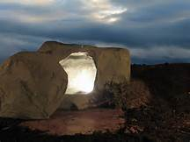
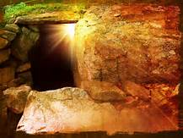
A Unique Ministry
With Unique Rewards

Slide 32
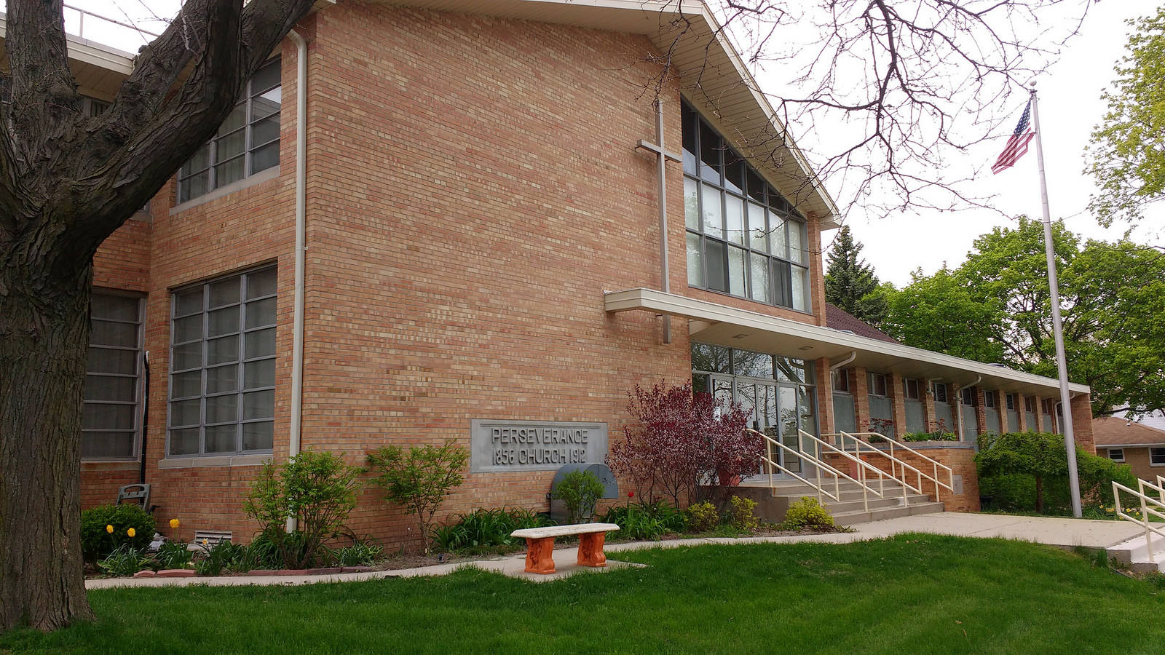

Slide 33
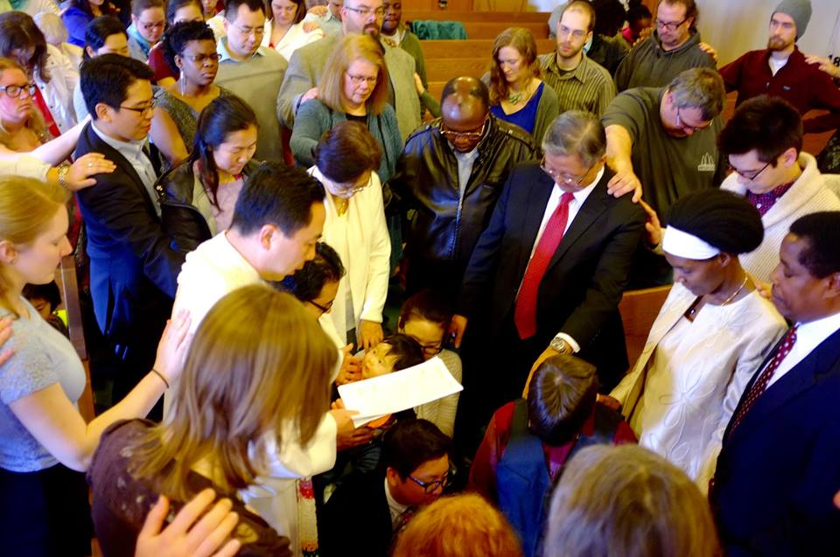
Church of All Nations

Slide 34
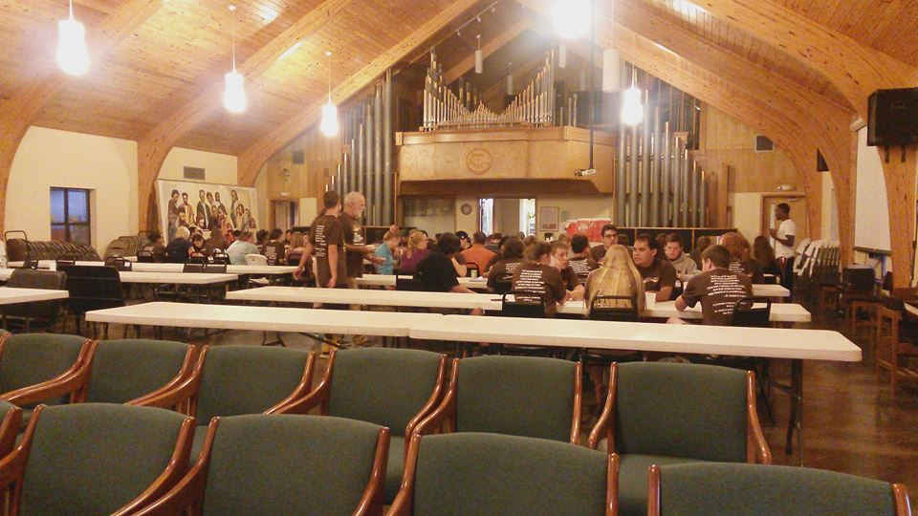
Camp Restore

Slide 35
SpringHouse Ministry Center

Slide 36
Toward The Better Country
“If they had been thinking of the land that they had left behind, they would have had opportunity to return. But as it is, they desire a better country, that is, a heavenly one.” – Hebrews 11:15-16

Slide 37
Wise Counsel From Your Peers
Ground yourself and others in prayer, Bible study, discernment
Make sure communication about process is frequent and transparent
Understand resistance as caring and go one-by-one for grief counseling to the most resistant
Work toward consensus vs. majority rule
Plan a blessing and release worship
Help the people find meaningful ways to leave a legacy
Preach with a focus on God's gentle compassion AND great dream for what they can make possible as their legacy…
… and that it is God's dream not theirs!

Slide 38
Questions?
Comments?

