Slide 1
Ministry in Times of Church Discernment and Closure:
Webinar for Intentional Interim Ministers
Living Legacy: Church Legacy and Closure Workbook Presenter: David Schoen

Slide 2
“Is the term "closure" used by our church today, a state of death for a local church or a statement of transition to a new beginning?”

Slide 3
What is Closure
Definition of Closure
clo·sure, noun klō′zhər
1. The act of closing or the state of being closed: closure of an incision.
2. Something that closes or shuts …….
7. a sense of completeness: a need for closure.
As the definitions indicate, when we hear closure we think of something closing, shutting down, which usually has a negative connotation. But there is also the meaning and experience of closure that includes a sense of completeness. Helping a church experience a faithful sense of completing ministry and mission is the goal of Living Legacy.

Slide 4
Living Legacy Workbook
What is the Living Legacy Workbook?
Local Church Ministries UCC, Church Building & Loan Fund, and United Church Funds created the Living Legacy Workbook as a discernment and decision-making resource for Legacy Congregations, churches seeking to faithfully complete their ministry and seed new ministries. This mixture of narratives, guidelines, inventories and resources is designed for use by leaders from all church settings who work with congregations who are considering their culminating ministry and missional legacy.
Who uses Living Legacy? • Congregation leader/member wondering about your church's future • Congregation seeking guidance in making the decision to close • Pastor guiding your congregation in a legacy decision • Conference staff or volunteer consulting congregations • Interim pastor specializing in transitioning congregations • Association Committees on Ministry assisting churches

Slide 5
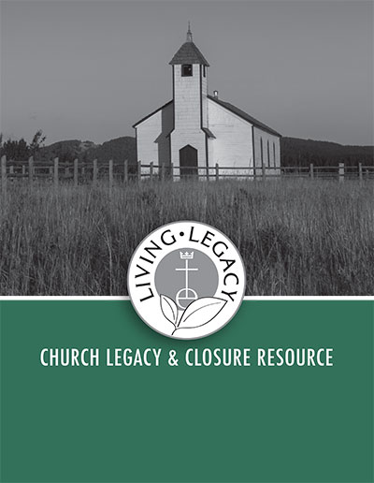
What is in the Living Legacy Workbook?
Chapters in the Living Legacy Workbook address: Challenges churches encounter in ministry today, Tools for congregational assessment & decision-making, Legacy Inquiry and Conversation guide, Pastoral care and leadership in a legacy situation, Stewardship of church real estate and financial assets, Legal Issues and Process in Church Dissolution, Bible Studies and Discussion Questions, and Bibliography of helpful books, websites and resources.
Chapter 1 – Mind the Gap Chapter 2 – Is it Time? Chapter 3 - Legacy Inherited, Legacy Futured Chapter 4 – Role of the Legacy Pastor Chapter 5 – Buildings as Living Legacies Chapter 6 - Financial Assets as Living Legacies Chapter 7 - Legal Issues in Church Dissolution Bible Studies and Discussion Questions Bibliography

Slide 6
Using the Living Legacy Resource
For ‘Threshold’ Congregations, churches discerning their future
Start the conversation and questions early – Warning: Don’t avoid or delay discussion!
Contact your Conference or Association for conversation and resources
Read Living Legacy Introduction, Bible Studies and Chapter 1, 2 & 3 for discussion
“Mind the Gap” Chapter 1 for review of church and culture today
“Is it Time?” Chapter 2 for church assessment review
“Legacy Inherited, Legacy Futured” Chapter 3 for review of church legacy & mission
Consider options for further assessment and discussion of church mission and future
Work within congregation and with conference and others to plan steps into church future

Slide 7
Resources for Threshold Congregations discerning their legacy and future.
Conferences – Contact your Conference or Association Office for services they provide.
Partners in Building and Partners in Vision – Contact Church Building & Loan Fund, UCC info@cblf.org
New Beginnings Assessment – Contact Congregational Advancement, Support & Assessment, UCC www.ucc.org/new-beginnings
reVision – Contact Center for Progressive Renewal www.progressiverenewal.org
If your congregation is considering concluding your ministries, stewarding your building and assets to shape a mission legacy, there is a resource for churches in the process of closure and legacy decisions – Living Legacy: Church Legacy and Closure

Slide 8
Using the Living Legacy Workbook
For Legacy Congregations making the decision to close and leave legacy
Start the conversation and questions early – Warning: Don’t avoid or delay discussion!
Contact your Conference and Association for conversation and resources
After discussing Living Legacy Introduction, Bible Studies and Chapter 1, 2 & 3, read
“Role of the Legacy Pastors” Chapter 4 to discuss ministry of pastor and lay leadership
“Church Building as Living Legacies” Chapter 5 to review options for church real estate
“Financial Assets as Living Legacy” Chapter 6 to review options for financial assets
“Legal Issues for Church Dissolution” Chapter 7 to consider legal responsibilities and process
Determine within the congregation and with your conference & others, steps for closure, legacy and affirmation of church ministry.

Slide 9
What is a Legacy?
Definition of LEGACY
leg·a·cy, noun leɡəsē
1: a gift by will especially of money or other personal property: bequest
2: something transmitted by or received from an ancestor or predecessor or from the past, ‘the legacy of the ancient philosophers’
As the definition above indicates, when we hear the word “legacy” we often think first of money. But there is also that second meaning of “legacy” that is so important to a church.

Slide 10
Church Legacy and Church Closure
When a big tree falls it can provide a stage for new life. Those fallen tree trunks are called Nurse Logs. Tree seedlings growing on nurse logs do better than plants on the forest floor because they are closer to sunlight and feed on rich nurse log nutrients, minerals, moisture, and warmth from the decaying trunk
In closing many congregations faithfully provide a missional legacy that can provide a stage for new life, nurturing the growth of many other ministries including the planting of new congregations.

Slide 11
Using the Living Legacy Workbook
A Congregation Case Study on Closure and Legacy
Congregation was founded in the 1960’s
In 2015, 48 Members and 15 in Worship Attendance
Legacy Group was created to make recommendations to Church Council
Congregation began studying Living Legacy in 2015
Congregation was in touch with their Association/Conference
Congregation employed an attorney and real estate agent

Slide 12
Using the Living Legacy Workbook
A Congregation Case Study
Congregation had a buyer for real estate ready to close in February, 2016
Church and Attorney worked to settle outstanding debts, payments and obligations
Pastors contacted the national ministries in January 2016 with Legacy questions Reminder – only tax-exempt organizations can receive income from church legacy assets
Legacy group and pastors contacted United Church Funds for legacy investment information
A Legacy Covenant and process was developed by pastors and legacy group

Slide 13
Using Living Legacy Resource
LEGACY COVENANT Document
The (congregation) established these purposes shortly after it had its first worship service: share in the worship of God, provide Christian nurture for our children, grow in discipleship through study, minister to each other, serve the welfare of our community, proclaim the gospel of God's love to all people, strive for justice and peace
During its 55 years of ministry, the congregation has demonstrated the importance of coming together in community to support one another during worship, fellowship, study, and actions that take this spirit into the world.
We want to perpetuate those same values, which we have developed throughout our history. With our legacy, we can expand our reach beyond our church to the community, the State, the USA, and around the globe. We have the opportunity to: Feed the hungry, Provide housing and homes, Improve healthcare, Foster educational opportunities for all God’s children, Generate new ministries for justice and peace
While recognizing that the church of the early 21st century and beyond will differ greatly from the church of the mid 20th century, we seek to support the evolving organizational structures and new mechanisms for the delivery of those values that support our original purpose.

Slide 14
Using the Living Legacy Workbook
A Congregation Case Study
Based on the Legacy Covenant, the Church Council and Congregation made legacy decisions from the church real estate sale to generously support:
Local social and human service agencies
Conference and Wider Church organizations
Living Legacy Endowment Fund, United Church Funds
With the support of the Association the congregation planned their final Sunday Worship in celebration of the congregation’s legacy and for deconsecration of their building to which they invited the community and other churches.
Church members were given membership certificate and assisted to find new congregations

Slide 15
Using Living Legacy Resource
A Congregation Case Study
Church and Legacy Process and Timeline
Legacy and Closure Process - Two Years from 2015 through 2016
Study and Recommendations
Legacy Decisions, Sale, Closing Worship
Facility clean-out, Church Records and Property distribution, Sale and Financial Settlements
Church Council appointed small group with authority to make continuing decisions after closing worship service

Slide 16
The Role of the Legacy Pastor – Living Legacy Chapter 4
A legacy pastor will need sufficient self-awareness, coaching, and/or spiritual direction so as to not misfile their underlying assessment about their own ministerial career into the process and decisions their church will undergo on the legacy journey.
“ My support came from our beloved Interim CM” – “Community of Practice” - “ The Collegium of Intentional Interim Ministers, plus a couple clergy friends” - “ Spiritual direction training; print resources; one or two capable, visionary, courageous lay leaders” – “ I can't imagine how hard this would be with leadership that was not mature and focused”
Legacy Pastors have careful work to do with wider church advisors to build trust, respect, communication and transparency with congregation leaders. The support and respect of congregation and judicatory leaders lessens the stress on legacy pastors.
Reminder – review and respect the Code of Ethics for Authorized Ministry.

Slide 17
Reflections on the Ministry and Leadership of Pastors in Closing Congregations and Legacy Churches
“Many churches in the last stages of their life do not have adequate pastoral care. Those who do are at a distinct advantage, as long as the pastor has the courage to assist them in the discernment of the future. You are the best person to balance pastoral care with prophetic witness. You can engender trust that is probably not afforded to your judicatory leader. And you know better than anyone the specific gifts and needs of members who may need to move on to other churches. Do not underestimate the power of your presence or the importance of your ministry to a church that is considering closure.” From Toward the Better Country by Rev. Gail Irwin
“Part of the uniqueness of this ministry is the special reward that is reserved only for those who are willing to engage a congregation at the deepest possible level with the promise of the gospel – that ours is a God of life and that death doesn’t have the final word. If you’re not willing to go there, this probably isn’t the ministry for you. But, if you are, you’ll know you went to the tomb with the people and helped them move through to life on the other side.” Rev. Jonathan New, Associate Conference Minister for Stewardship & Financial Development

Slide 18
Ministry in Times of Church Discernment and Closure

Slide 19
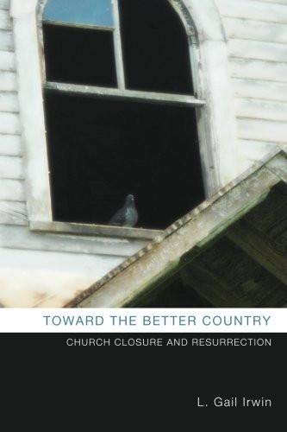
Additional Resource for Church Closure and Legacy See Bibliography – Living Legacy
Finishing with Grace – A Guide to Selling, Merging or Closing Your Church, Linda Hilliard and Gretchen Switzer,
Ending with Hope: A Resource for Closing Congregations, Beth Ann Gaede,
UCC Vital Signs and Statistics Blogs on Church Closure and Legacy Mind the Tiller: Leading a Church to Closure https://www.bu.edu/cpt/2016/10/28/mind-the-tiller-leading-a-church-to-closure/ Caring for Pastors in Closing Congregations https://carducc.wordpress.com/2017/07/10/caring-for-pastors-in-closing-congregations/ What Do 111 Closed Congregations Tell Us? https://carducc.wordpress.com/2016/10/31/what-do-111-closed-congregations-tell-us/ Final Act of Faith: Closing Congregations Nurture Next Generation of Mission https://carducc.wordpress.com/2017/03/06/final-act-of-faith-closing-congregations-nurture-next-generation-of-mission/

Slide 20
What people say about Living Legacy Workbook
The Bible study material was very helpful in developing a context for discussion and worship at a leadership retreat. "Considering the options" was very helpful in working with the leaders and again in presenting to the congregation. Also, "how your church's heritage lives on." The whole thing was very helpful to me as I planned and carried out a nearly year-long effort to bring the leaders and then the congregation to a full and frank assessment of our situation and a decision on how to step into the future.
Provides information most churches wouldn't think about and offers a sense of resurrection through legacy.
So far we're just beginning this conversation and have not worked through the booklet yet, but what I have seen of the resource, I believe that it will be very helpful.

Slide 21
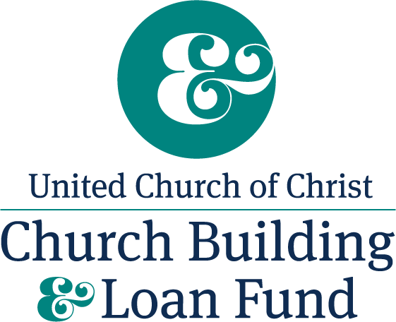
For more information on Living Legacy
Be in touch with your Conference or Association Office
Go to http://www.ucc.org/legacychurch
Email LegacyChurch@ucc.org
Contact Rev. David Schoen Minister for Church Legacy & Closure Church Building & Loan Fund, UCC 216-736-3839 dschoen@ucc.org

Slide 22
For more Information
United Church Funds
Contact
Howard W. Hawkins III, Director, Business Development
Phone: 212-729-2620 | Email: howard.hawkins@ucfunds.org
Association of UCC Intentional Interims
Contact
Rev. Marlea Gilbert
http://aucciim.weebly.com/contact.html
CHANGE HAPPENS
We Can Help
Association of
United Church of Christ
Intentional Interims
Ministers

Slide 23
Ministry in Times of Church Discernment and Closure: Webinar for Intentional Interim Ministers
THANK YOU!
BLESSINGS IN YOUR MINISTRIES

